Slide 1
c.1450 - c. 1750
Global Interactions
Erin, Savannah, Dan, Will, Ryan

Slide 2
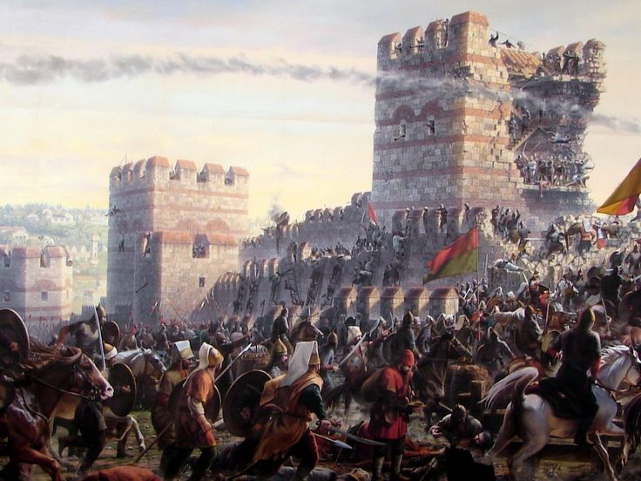
Ottomans Capture Constantinople- 1453
AP Themes: Theme #1, Theme #3, and Theme #4
The Ottoman Empire defeated the Byzantine Empire which expanded them into Europe, bringing forth more control for the Ottomans but also migrated their culture North, and brought into view the amount of resources that the Middle East had to Europe, causing trade to become a major thing between the Indian Ocean World and Europe.
Historiographical Perspective: Military, and Economic
This was under a military perspective due to the fact that the Ottomans took over the capital of the Byzantine Empire through war. The economic factor took place when the Ottomans began to trade with Europe, showing the them the rich amount of resources located in the Indian Ocean World.
Periodization:This marks the beginning of the Age of Exploration, because it drove Europe to the Indian Ocean World causing them to want to find quicker and easier ways to get there, such as sailing West and accidentally hitting the Americas.
Argument: This event is easily the most important event in this era of global interactions, because it caused Europe to get involved with the Middle East, and furthermore Africa and Asia, and eventually America when they try to find an easier route to those places.

Slide 3
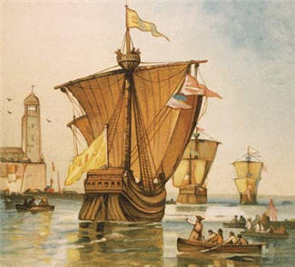
Columbus sails the ocean blue- 1492
A.P. Theme 1- Columbus brought many Europeans and other settlers migrated to the Americas after Columbus discovered the land.
A.P. Theme 4- With Columbus and other Europeans coming to the America’s, this lead to trade and commerce and the creation of the Columbian Exchange and the Atlantic Ocean world.
Historiographical view- Columbus sailing the ocean blue is a huge social aspect for the world. When Columbus settled into the Americas, it lead to the creation of the Atlantic Ocean World and settlers into America, creating many different settlements in which Europeans lived at.
Periodization- This is an extremely important factor because it created a world wide trading area and it also lead to the creation of the United States. On the other hand, this brought over many diseases and other bad things like slaves.

Slide 4
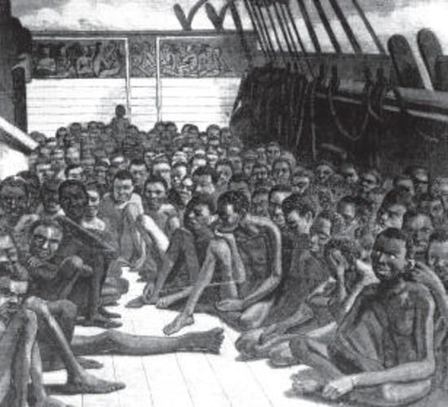
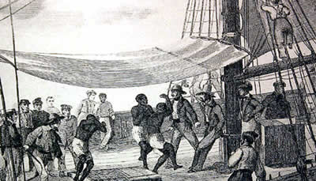
Slaves to America - 1502
A.P. Themes- Theme 1, Theme 4, and Theme 5.
Interaction between humans and the environment- Slaves were forced by primarily white men to go onto ships, in tight areas to be enslaved by others upon arrival. Creation, expansion, and interaction of economic systems- Slaves being brought to America was a form of trade and commerce, therefore it created a type of economic system in a sense. Development and Transformation of Social Structures- Fitting the subcategory of social and economic classes, becoming a slave put one in the lowest of low social classes, as well as the poorest of the poor because most were unpaid.
Historiographical perspective- It would be under the perspectives of Racial, Social, and Economical. Racial, for obvious reasons, was the main reason for African-American enslavement. It was a social
Periodization- This is an imperative event for 1450-1750 Global Interactions due to the fact that slavery shaped a large portion of historical events and people. It began a movement within those black and white against slavery. As awful as slavery was, it connected those who wanted to put an end to slavery. There were many numerous negative effects that came from slaves being brought to America (i.e. Beatings, Racism, Segregation, Witch Hunts, Civil War, etc.) That being said, strong leaders were formed and strength was put to use within the American community who did not want slavery to exist and that made a huge impact on American history. .

Slide 5
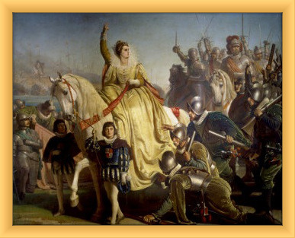
Defeat of the Spanish Armada- 1588
AP Themes- Theme #2 and Theme #3
Theme #2- Development and interaction of cultures
The attempted invasion of England was caused by religion. The Spanish felt the need to force the catholic religion onto the protestant English.
Theme #3- State building and forms of government.
After the defeat, England became a world power, fitting into the ‘Empire’ section of this theme.
Historiographical Perspective- Military, Economic, and Social. The military aspect is clear, the fighting of the Spanish and English. After the defeat, England became a great empire and developed many colonies that amassed wealth for the nation and brought them into economic power. And finally, the defeat cemented the social class of the Spanish, second to the English.
Periodization- This marked the beginning of the English Empire. Before the Spanish Armada was defeated, Britian was just a small country trying to avoid altercation between themselves and the larger, more powerful Spain. After the Armada was defeated, England had no country standing in their way of becoming an imperialist power.

Slide 6
The Founding of Jamestown- 1607
The founding of Jamestown was America’s first English colony located in Virginia.
AP Theme: Connects to AP theme #1, specifically patterns patterns of settlement and migration. The reason for migration was tempation of gold, and the pattern of settlement was due to the tobacco discovered there.
Historiographical perspective: Had a dominant economic perspective. Gold was the motivation to travel to Jamestown, however tobacco was what made it succeed economically and thrive.
Periodization: This piece of history mark the beginning of the English is America. It is largely based on environmental determinism. After a few failed attempts, harsh weather, and diseases, Jamestown was finally able to survive as America’s first English colony.
Argument for selection: This historical event is definitely one of the most important events during this time period because it shaped the rest of English colonization in the Americas. It leads to the modern world.

Slide 7
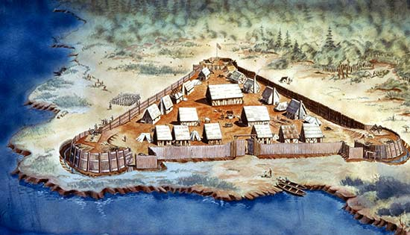
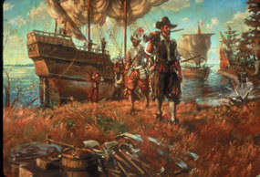
Why we chose these events
All events in our country’s history are important, and each take part in forming what we know as history today. But with that being said, the five events we chose stood out to us as events we wanted our classmates to be more informed about. Our first card was from c. 1453 and it was when Ottomans capture Constantinople. This was a major event for our time period especially due to the fact that the concretization marked the beginning of the Age of Exploration. What that means is this event gave off a domino effect for all events falling after it. Our final card was from c. 1607 and it was the Founding of Jamestown. This is an imperative event in our country’s history because it was the first permanent English settlement in North America.

